Slide 1
Stuff
Beyond
Development
Jason Yau

Slide 2
01
Documentation
02 Testing
03
CI/CD
04
ERROR LOGGING
Contents
Would
talk about

Slide 3
why these things matter?
?
?
?
?

Slide 4
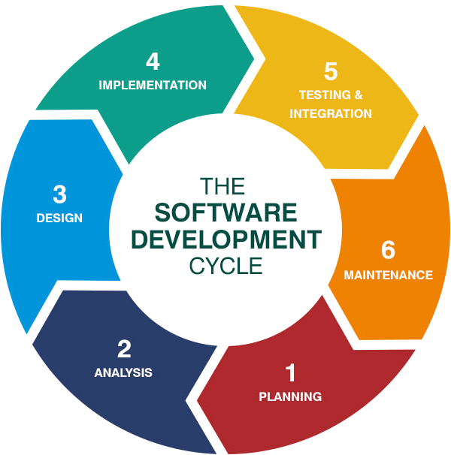
software development life cycle (SDLC)

Slide 5
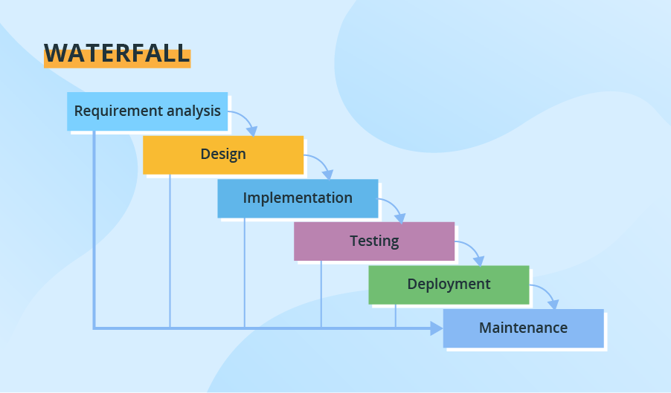
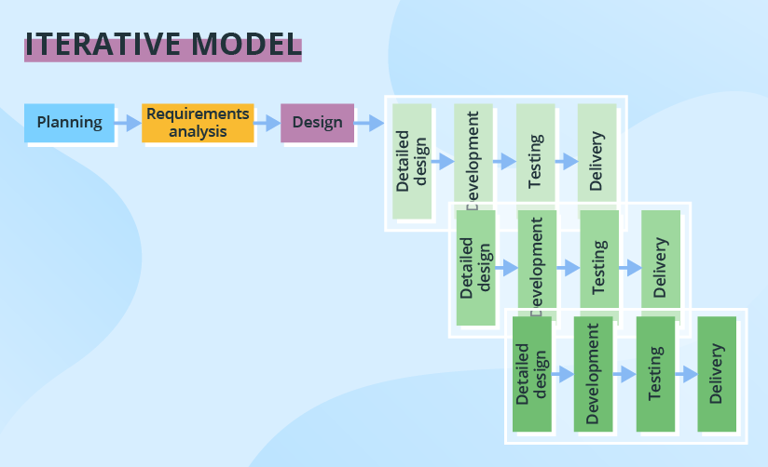
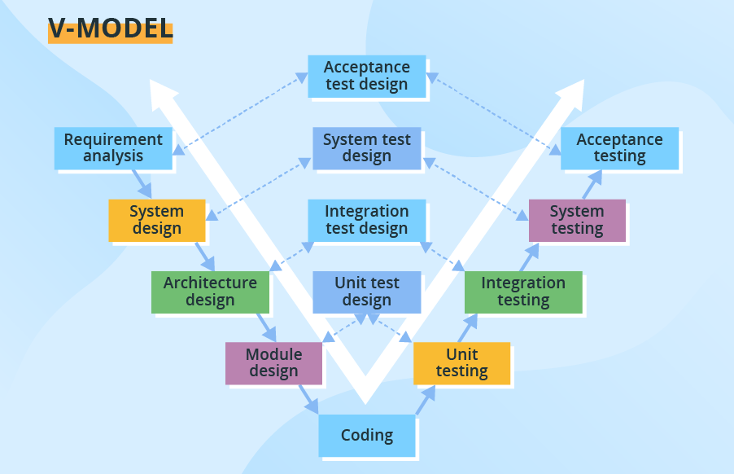
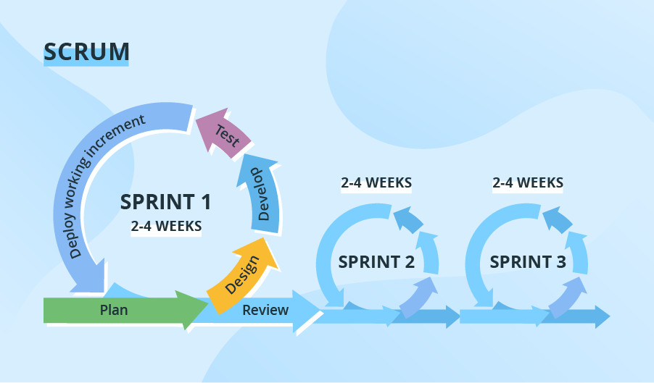
- AGILE
REF: https://www.scnsoft.com/blog/software-development-models

Slide 6


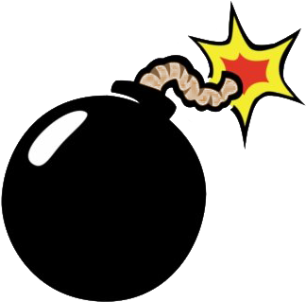
Current project structure
CLIENT_000
CLIENT_001
CLIENT_002
⋮
CLIENT_100
⋮
CLIENT_XXX

Slide 7
01.
documentation

Slide 8
Type of Documentation
Requirement Documentation
It is the description of how the software shall perform and which environment setup would be appropriate to have the best out of it. These are generated while the software is under development and is supplied to the tester groups too.
Architectural Documentation
Architecture documentation is a special type of documentation that concerns the design. It contains very little code and is more focused on the components of the system, their roles and working. It also shows the data flows throughout the system.
Technical Documentation
These contain the technical aspects of the software like API, algorithms etc. It is prepared mostly for the software devs.
End-user Documentation
Made for the end user which contains support resources for the end user.

Slide 9
— Steve McConnell
“Good code is its own best documentation. As you’re about to add a comment, ask yourself, ‘How can I improve the code so that this comment isn’t needed?’”

Slide 10
Documentation during development
01
Complex logic
02
Important variable / Control
03
Summary of module
04
client Changelog
Try to sum-up and restructure the logic to make the code much clearer
Try to achieve this by giving it a clear and suitable name
Give reader a walkthrough of the module.
What feature it provides?
How people usually call the functions?
Any other modules related?
Markdown client specific changes which apart from the CORE

Slide 11
Pros and cons of Documentation
Advantage:
Helps in keeping the track of all aspects
Transfer the development , maintenance and knowledge to other developers
Improves overall quality of software product
It cuts down duplicative work
Makes easier to understand code
Helps in establishing internal coordination in work
Disadvantage:
Time consuming
Documentation updates don’t match the updated code, due to time pressure
Documenting is not so fun, its sometime boring to a certain extent

Slide 12
02.
Testing

Slide 13
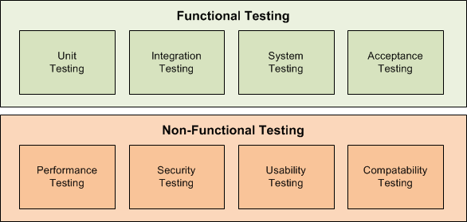
General Type of Testing

Slide 14
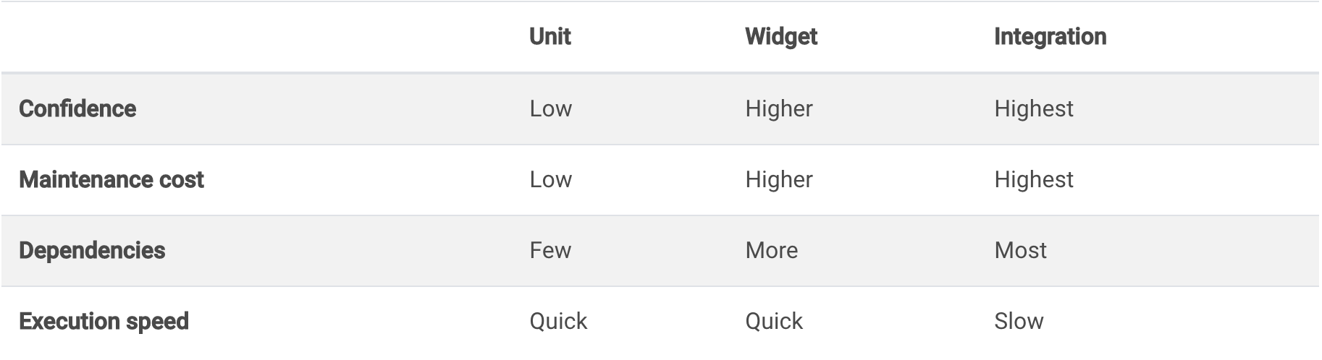
Flutter type of testing
Notes that Widget Test is hard to implement when it is not a pure Widget that having dependency on BLoC State

Slide 15
03.
CI/CD

Slide 16

What is CI/CD?
CI/CD is a method to frequently deliver apps to customers by introducing automation into the stages of app development. The main concepts attributed to CI/CD are continuous integration, continuous delivery, and continuous deployment
REF: https://www.redhat.com/en/topics/devops/what-is-ci-cd

Slide 17
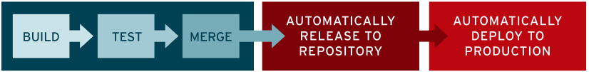
Stages of ci/cd
continuous integration
continuous delivery
continuous deployment
New code changes to an app are regularly built, tested, and merged to a shared repository. It’s a solution to the problem of having too many branches of an app in development at once that might conflict with each other.
The purpose is to ensure that it takes minimal effort to deploy new code. Changes to an application are automatically bug tested and uploaded to a repository, where they can then be deployed to a live production environment by the operations team.
Automatically releasing changes from the repository to production. It addresses the problem of overloading operations teams with manual processes that slow down app delivery. It builds on the benefits of continuous delivery.

Slide 18
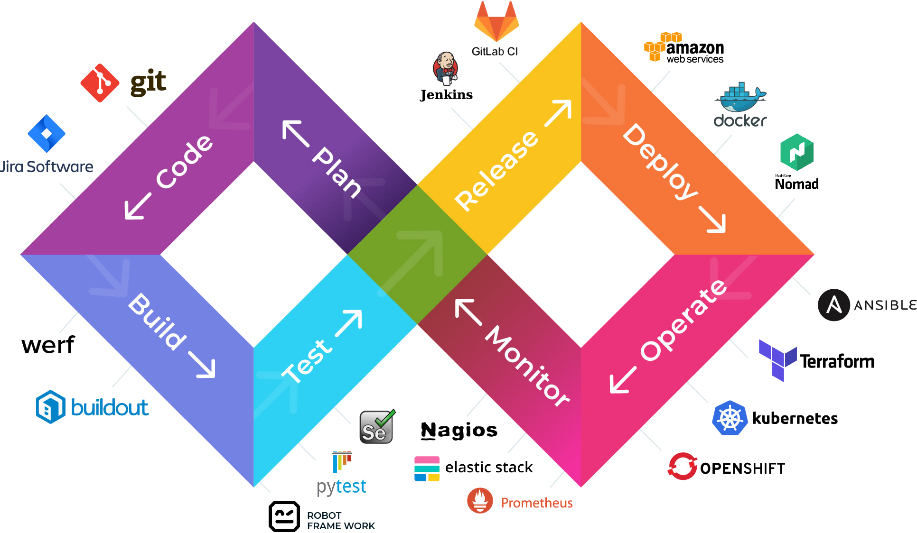
CI/CD Lifecycle and related tools

Slide 19
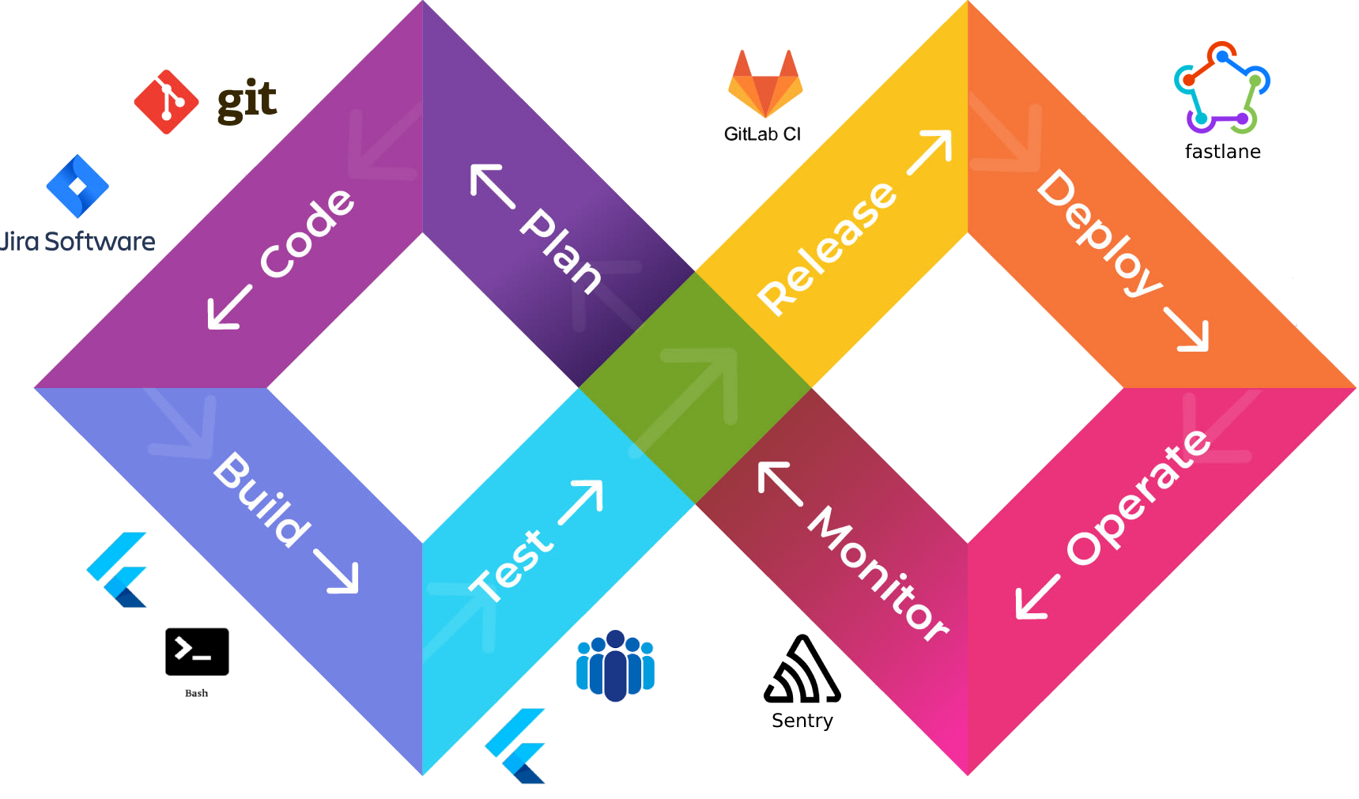
MOBILE APP 3.0 CI/CD

Slide 20
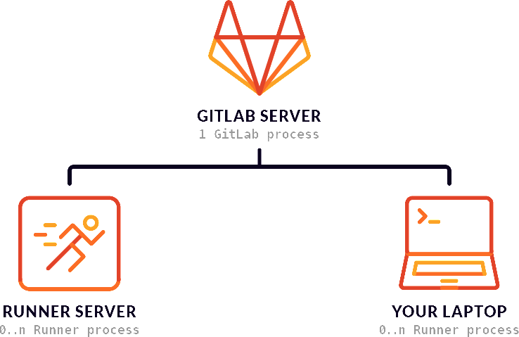
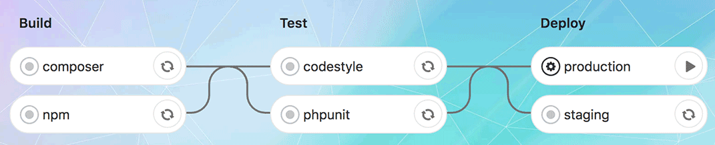
Git Hooks & Gitlab CI
Git Hooks:
Formatting codes before git commit
Align formatting to avoid unnecessary diff
Validate codes before git push
Ensure project can be runnable when other pull the latest code
Gitlab CI Setup:
Setup Gitlab Runner in Build Machine
Setup CI Script in project/.gitlab-ci.yml
https://docs.gitlab.com/ee/ci/
Trigger CI pipeline when commits are pushed to remote
Gitlab CI Actions:
Run Unit Test when commit received
Run Integration Test scheduled every night
Run Build script when tag received with pattern `BUILD_AYERS_PROD_1.2.3+4`

Slide 21
04.
Error Logging

Slide 22
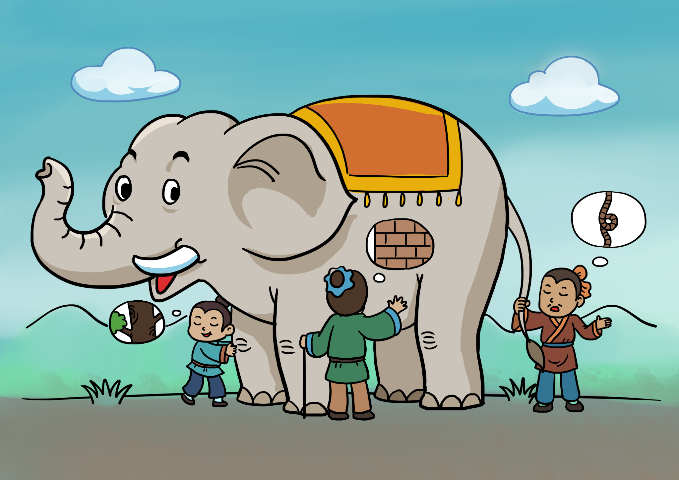

Client Bug Report
Mobile
Developer
Team

Slide 23
Why use sentry?
Flutter Recommended
Easy Integration
Statistics and TAG filtering
https://flutter.dev/docs/cookbook/maintenance/error-reporting
Capture errors from Flutter to Native, iOS to Android
Data visualization for error reporting and even performance.
Able to trace issue with multiple conditions

Slide 24
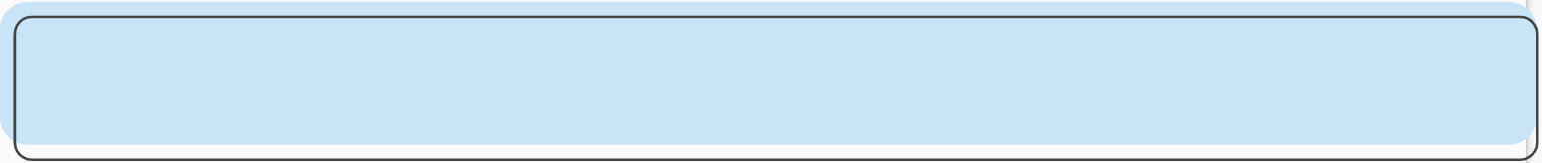
Log at the Proper level
01
Debug
02
warning
03
Error
Log at the Proper Format
01
Easier search
02
Clear flow
03
readability

Slide 25

END

